Slide 1
A Time for Everything
A Department Chair’s Survival guide:
Time Management-101 and other Useful insights Into the Job
Presented by Jim Gray Florida Atlantic University

Slide 2

Your Life is about to Change
But there are some things you can do to keep control of most of it.

Slide 3
Areas that will be different
Relationships:
Perceptions:
Environment:
With Peers
With Staff
With Administration
With Students
With Community
Your perceptions of others
Others’ perceptions of you
Relative importance of tasks
Critical attention to details
Authority and power issues
Work environment
Personal space and time
Control of your work
Control of your time
Preserving your sanity

Slide 4
Attributions are going to be made about your motives...

Slide 5
Attributions are going to be made about your motives... Even when you sneeze...

Slide 6
Attributions are going to be made about your motives... Even when you sneeze... (so get used to it)

Slide 7
Here are some other aspects of your new dilemma:
Students expect
Faculty expect
Dean expects
Instantaneous response
Absolute accuracy
Unfailing courtesy
Perfect diplomacy
...along with...
Fairness as they see it
Instantaneous response
Absolute accuracy
Unfailing courtesy
Perfect diplomacy
...along with...
Fairness as they see it
Instantaneous response
Absolute accuracy
Unfailing courtesy
Perfect diplomacy
...and “by the way”...
Peace in the department

Slide 8
Control over your time is not going to be nearly as easy as it used to be... “got a minute?”

Slide 9



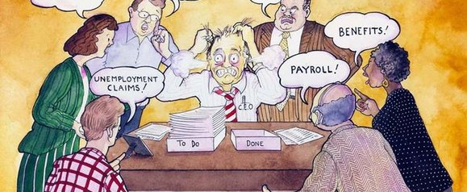

Here is the crux of the Time problem:
Stock Vector Illustration:
Image ID: 116435299
Stock Vector Illustration:
Image ID: 116435299
You cannot possibly remember all this stuff Yet you are expected to have it within arms length at all times

Slide 10
You are now “official” and that means... There is no longer any such thing as “off the record”

Slide 11
Pointers Collected by watching the best
Delegation
Relationships
Follow-up
Staff want meaningful tasks
Give specific direction
Make expectations clear
Set a date for completion
Know your people
Spend time really listening
Personalize communications
Listen first, pause, respond
The list of Critical Dates
The Reminder/Tickler File
Automatic reminders
Checking up as a regular event

Slide 12
Ever Have a Day Like This?
http://www.youtube.com/watch?v=ZVVOzLyt3fo

Slide 13
More Great Benchmarks
Take control of your office space and time
Stand up to greet people as they enter (this exudes courtesy)
For a short meeting—Never sit back down (try this, it works)
When it does not work, walk toward the door!
Ask these questions as politely as you can:
Can this wait until tomorrow?
I have about three minutes, will that be enough time?
What do you think should happen?
Does this consider everyone involved?
After a while, folks will get the message...

Slide 14
Things I have learnt thru Example
Have some data before you even ask the question
Ask where the data being presented to you originated
Don’t be shy about asking for corroboration
When you delegate responsibility, include confidence:
“I will support whatever decisions you make in my absence”

Slide 15
Develop Good Listener Skills it also helps to keep good notes!
Sometimes all the person wants is somebody to listen
When you think you understand, ask if your summary is accurate
What do you need? / Can you survive without it?
Always wait until you have “the rest of the story”
There is always another perspective to consider
Things frequently dissipate in the face of impartial attention
There are, however, exceptions to the rules...

Slide 16
URGENT vs. IMPORTANT few situations are ever “both”
Many times, just letting time pass, a majority of situations will resolve without your intervention
Other times, you have to act quickly and enforce your best judgment, to avoid a regrettable escalation
Knowing how to tell the difference is a key skill
Unfortunately you will learn this the hard way, like everyone who has gone before you...

Slide 17

Wisdom for the Ages
“This too, shall pass”
©1978 California Prune Advisory Board

